Slide 1
Pneumonia Detection based on Traditional Machine Learning and Deep Learning
Reporters: Jiawei Xiong, Yang Liu, Yicheng Wu, Cheng Zeng

Slide 2
CONTENTS
Background and significance of topic selection
Pneumonia Detection based on Traditional Machine Learning
01
02
03
Pneumonia Detection based on CNN
04
Pneumonia Detection based on RCNN

Slide 3
01
Background and significance of topic selection

Slide 4
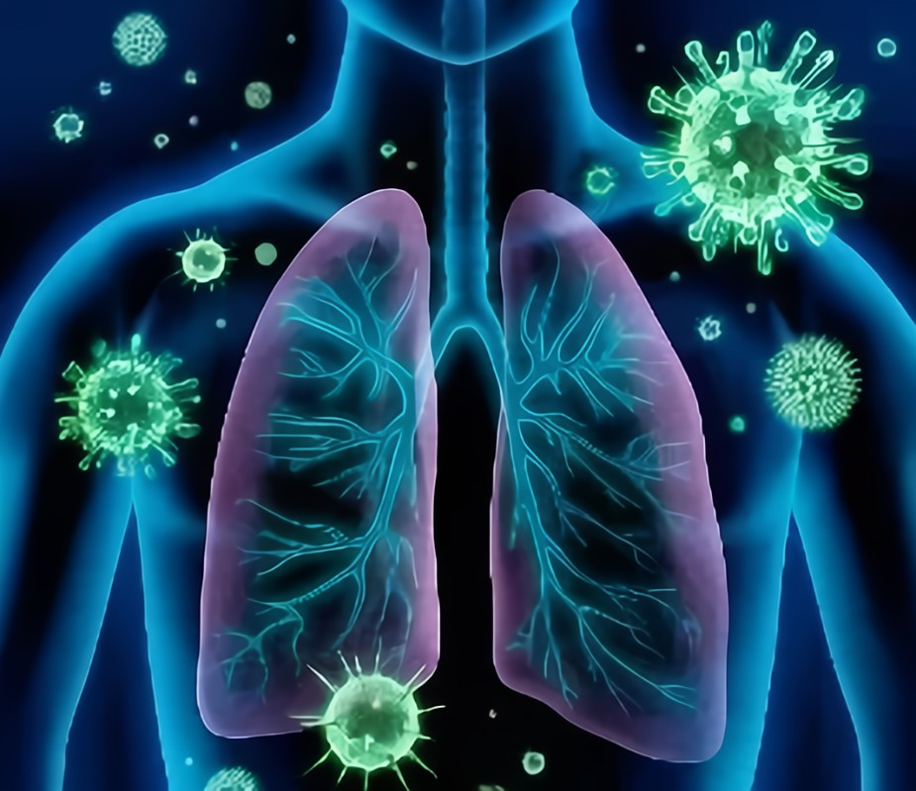
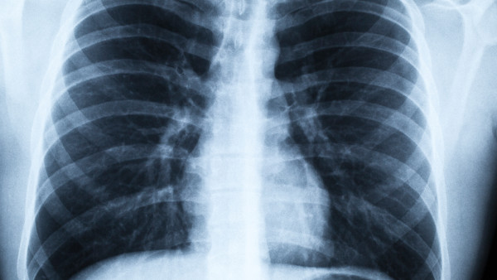
more than 15% of all under-five death
one of the top ten causes of death in the US
2015, more than 500,000 people visited visited emergency rooms
of which more than 50,000 died
design an automatic detecting system to help specialists do a judgment !
like position and depth of X-ray make
interpretation complicate

Slide 5
02
Pneumonia detection
based on
Traditional machine learning

Slide 6
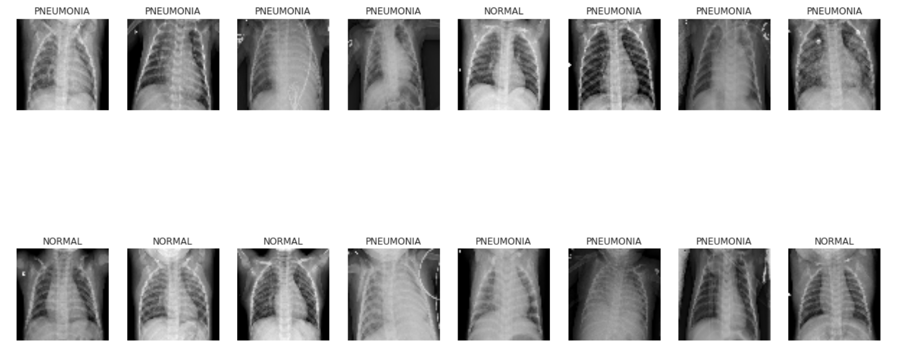
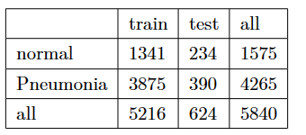
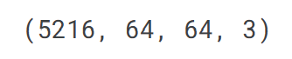
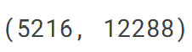
dataset
(64,64)
images and labels
load data
Labeled Optical Coherence Tomography (OCT)
and
Chest X-Ray Images for Classification
https://data.mendeley.com/datasets/rscbjbr9sj/2

Slide 7
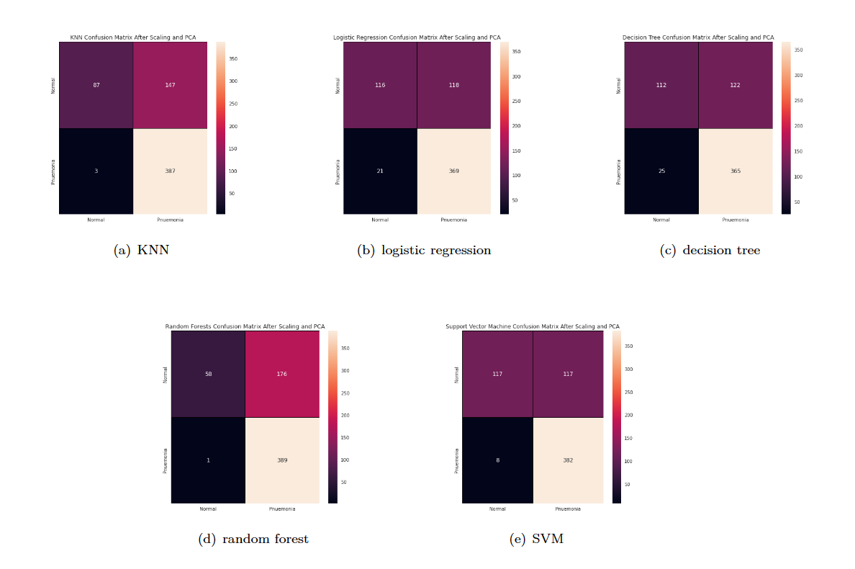
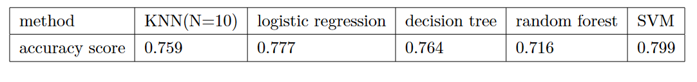
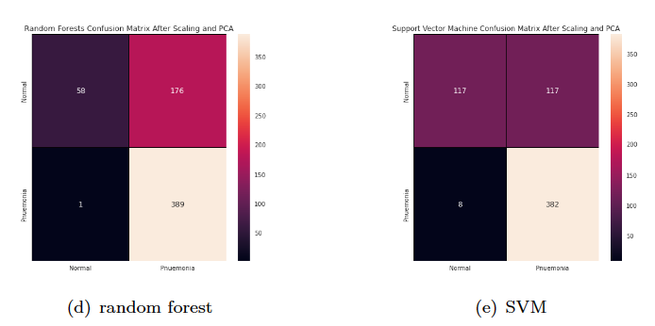
PCA:
remain 95% variance from 12288 to 546 dimension

Slide 8

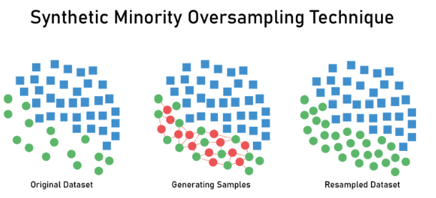
data balance
inbalanced!

Slide 9
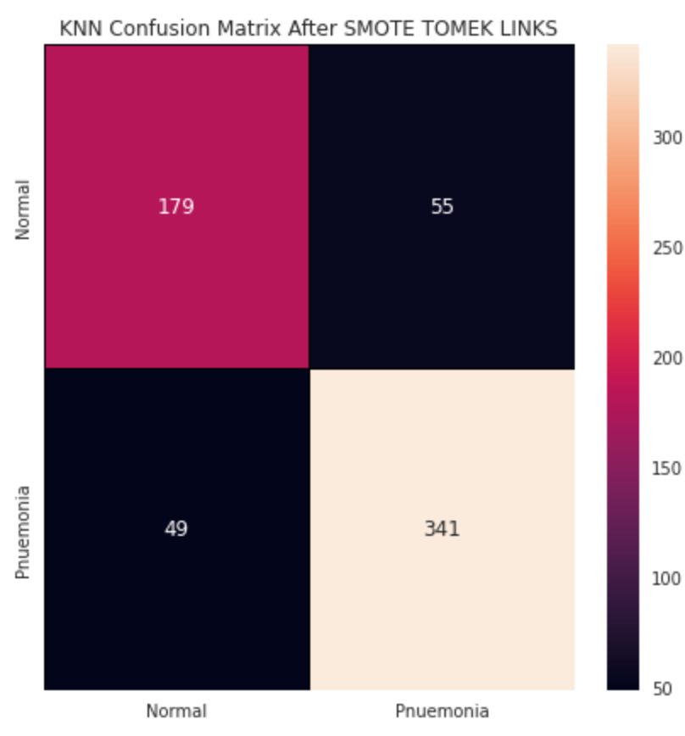
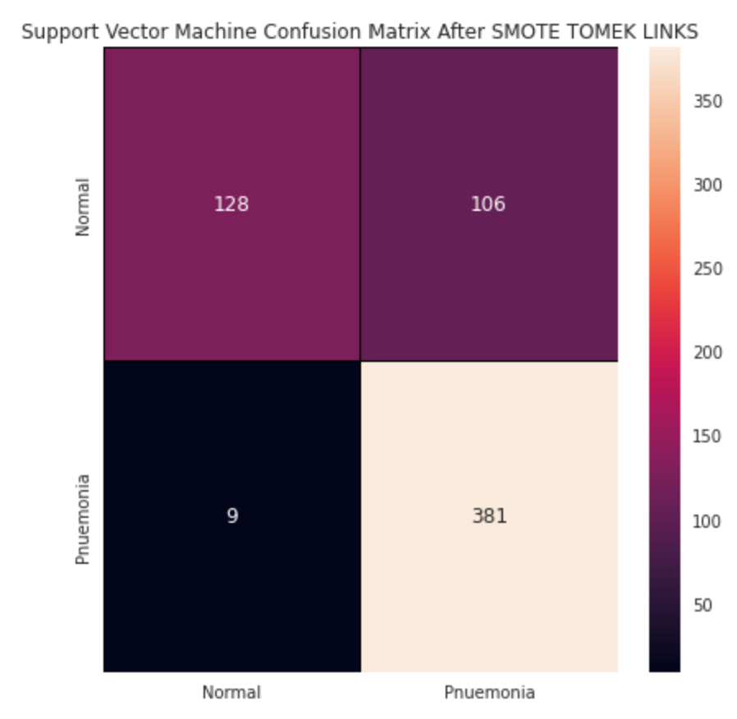
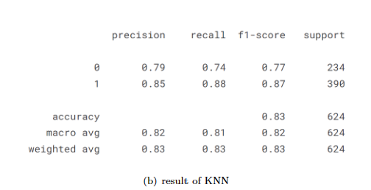
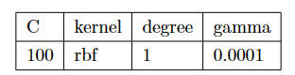
KNN and SVM
K=9

Slide 10
03
Pneumonia Detection based on CNN

Slide 11
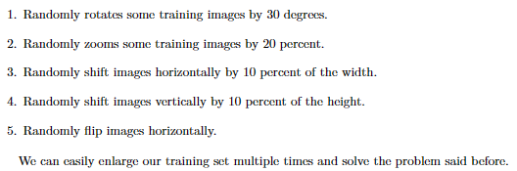
Data augmentation

Slide 12
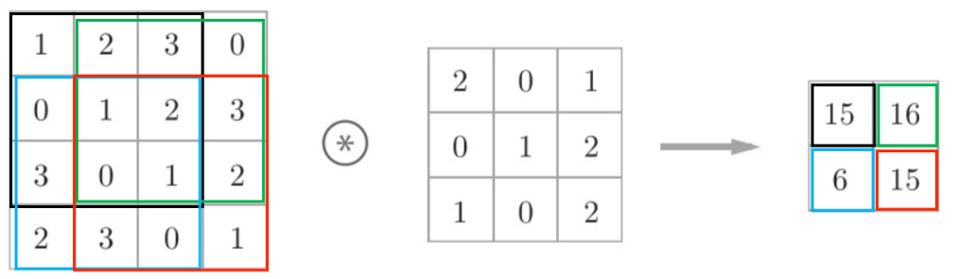
Convolutional layer
Fillter

Slide 13
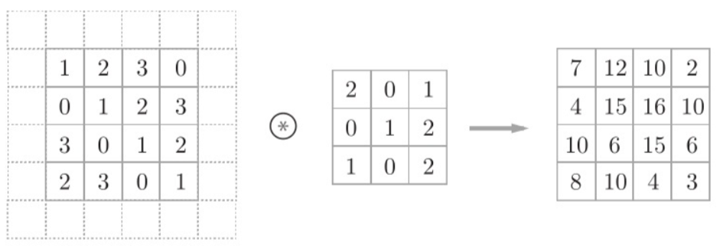
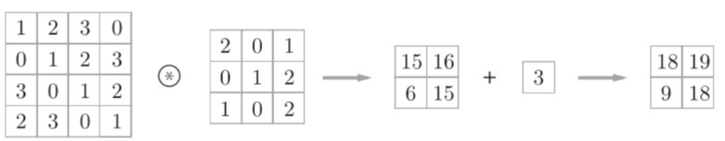
Padding and bias

Slide 14
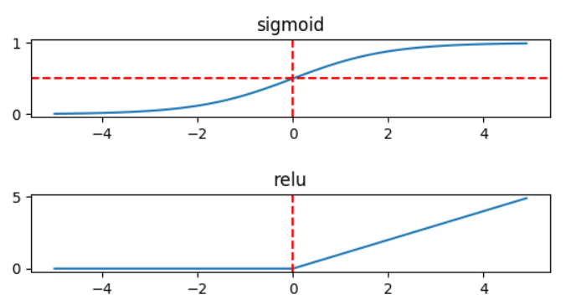
Activation functions

Slide 15
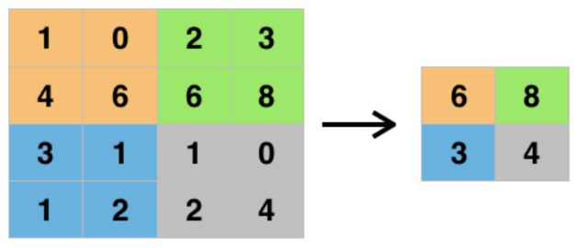
Pooling layer

Slide 16
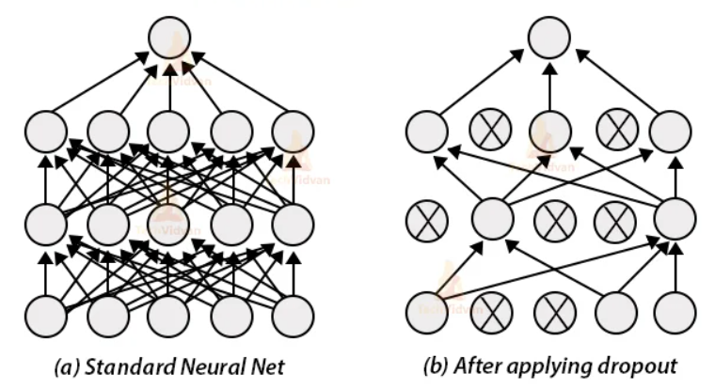
Dropout layer
The Dropout layer randomly sets input units to 0 with a frequency of rate at each step during
training time, which helps prevent overfitting. Inputs not set to 0 are scaled up by 1/(1 − rate)
such that the sum over all inputs is unchanged.

Slide 17
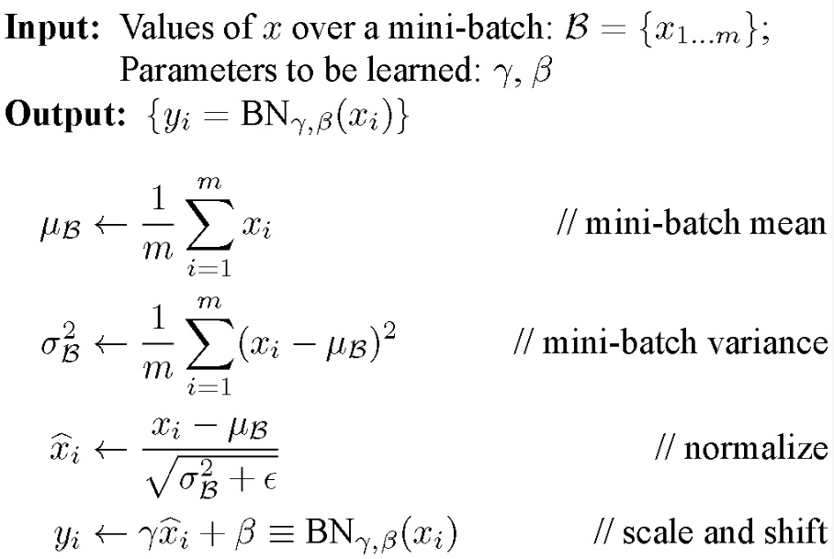
Batch normalization layer

Slide 18
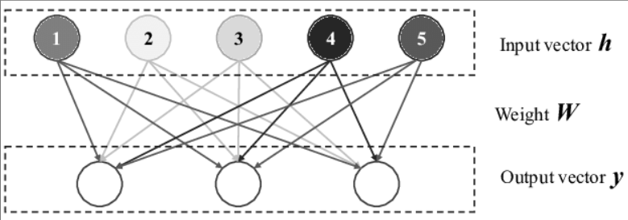
Dense layer

Slide 19
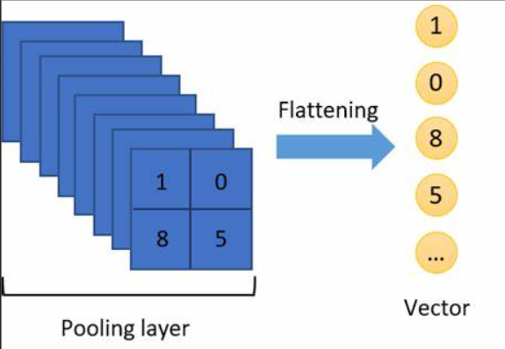
Flatten layer

Slide 20
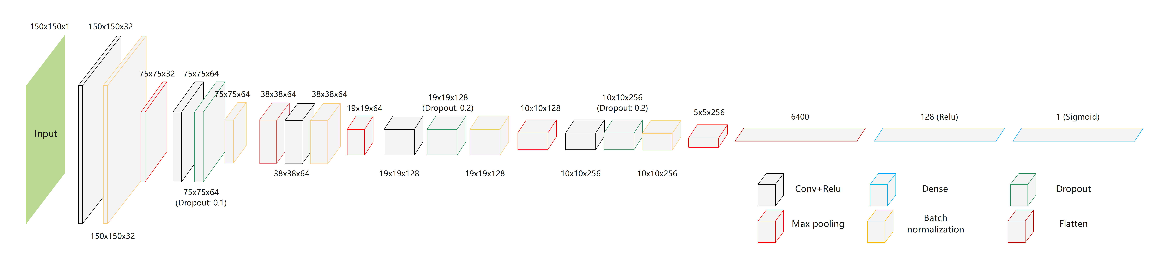
Final CNN

Slide 21
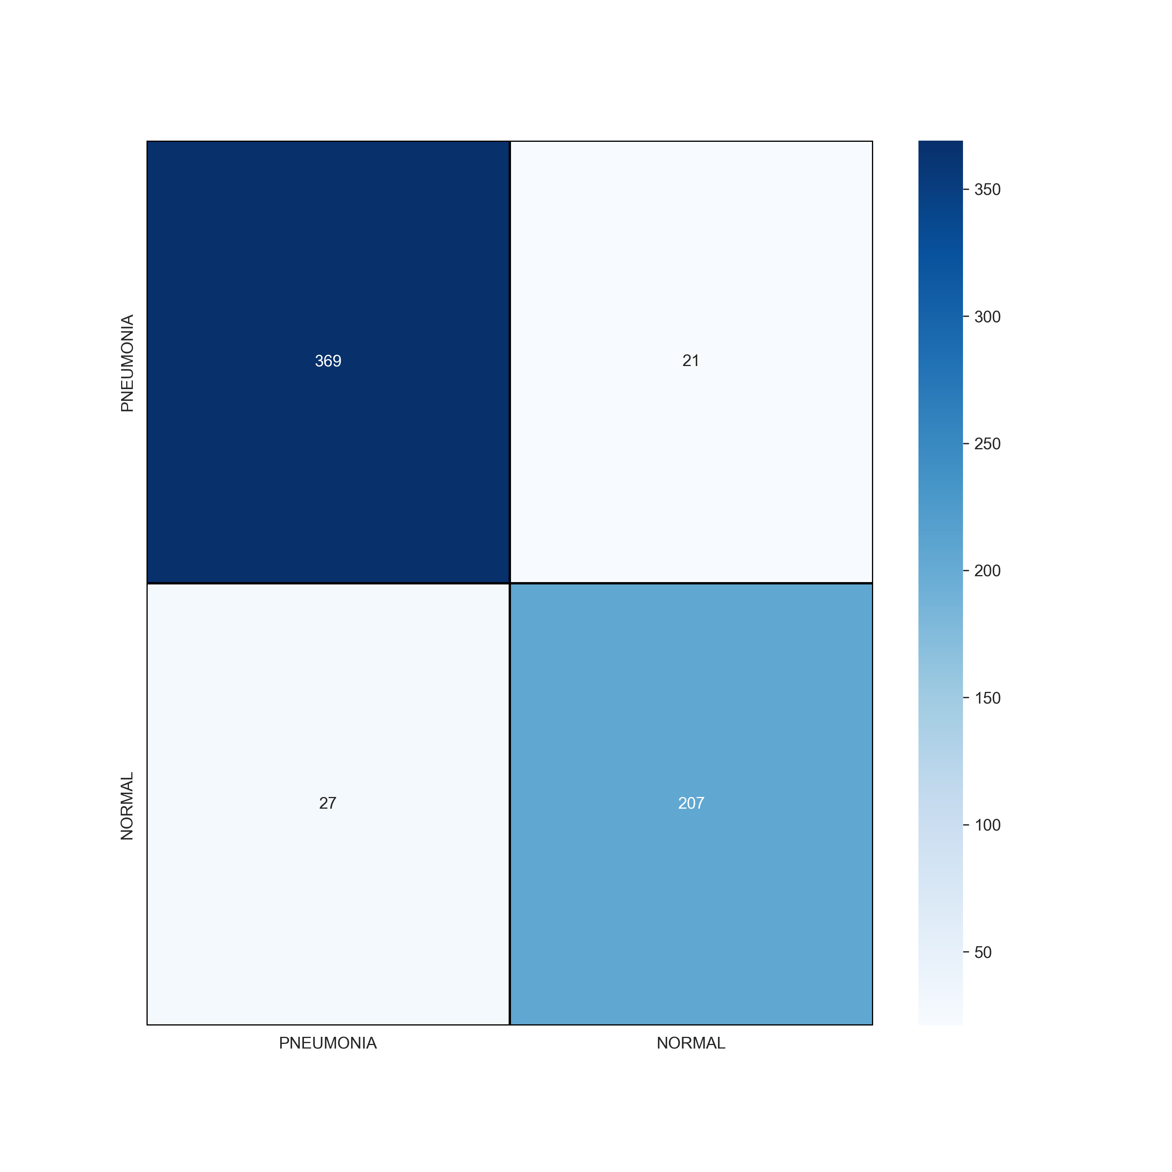
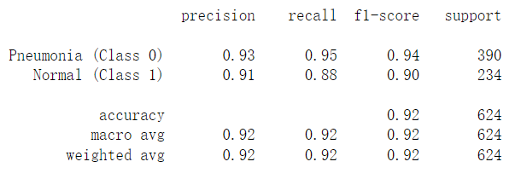
Test the model

Slide 22
04
Pneumonia Detection based on RCNN

Slide 23
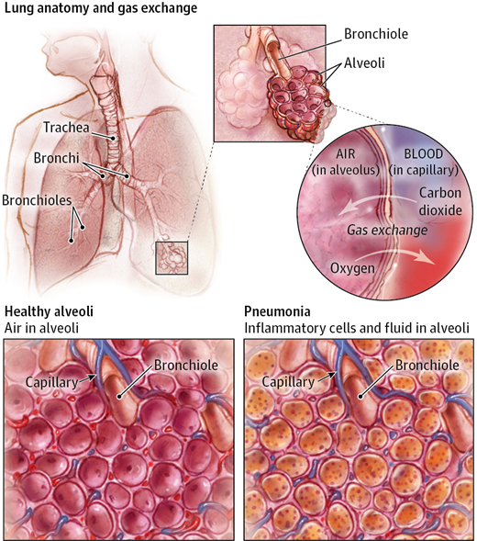
Pneumonia
Because of the infection and the body’s immune response, the sacks in the lungs (termed alveoli) are filled with fluids instead of air.
Pneumonia appears on a chest X-ray as opacity in the lungs with cloudy border.

Slide 24
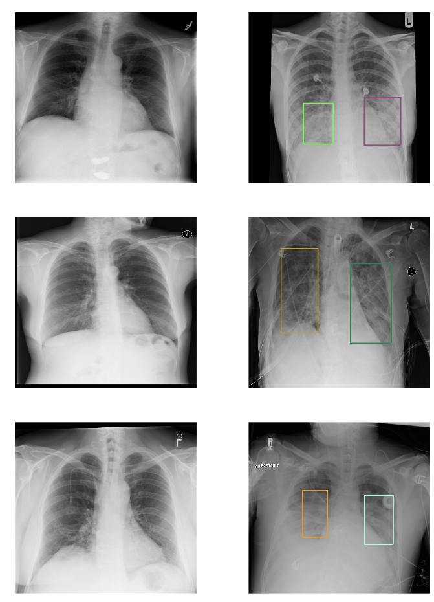
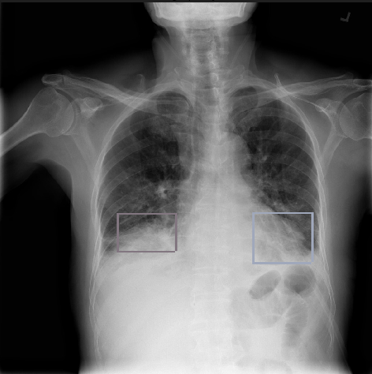
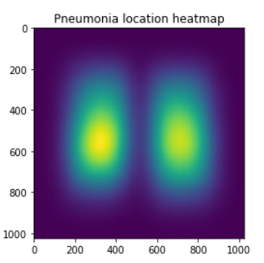
Dataset and lungs opacity
Dataset(box)
x-min y-min width height
Lungs Opacity
Pneumonia appears on a chest X-ray as opacity in the lungs with cloudy border.

Slide 25
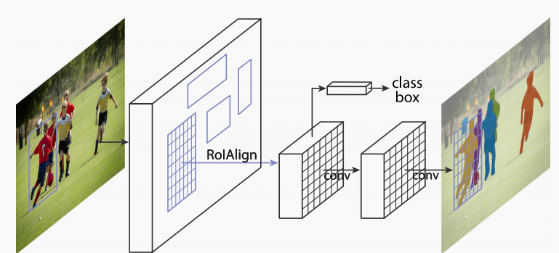
What is Mask-RCNN?

Slide 26
R-CNN
Fast-RCNN
Faster-RCNN
Mask-RCNN

Slide 27
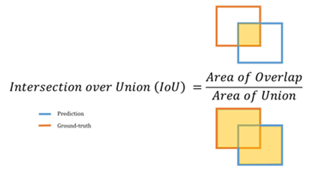
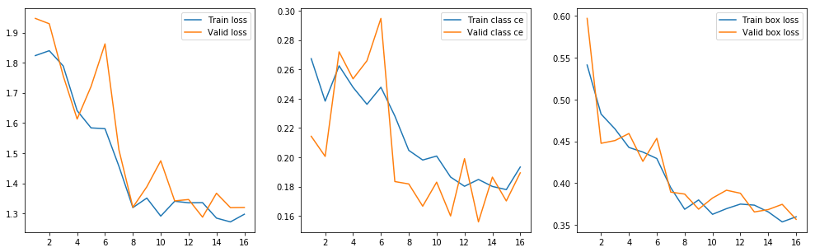
Process of training

Slide 28
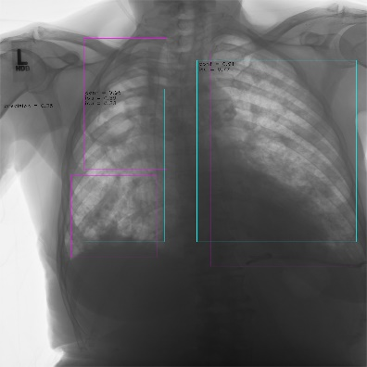
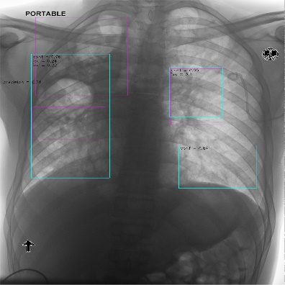
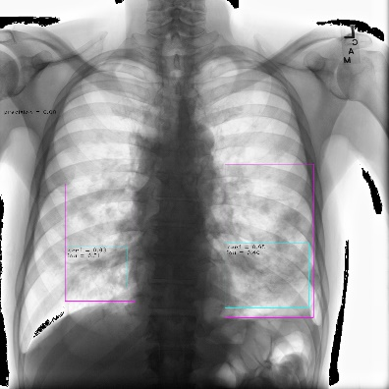
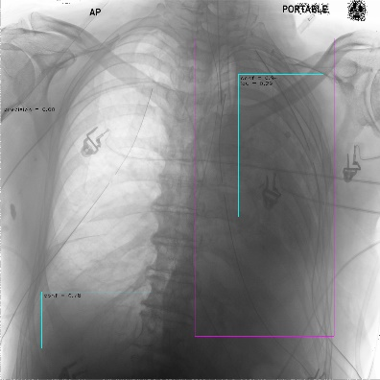
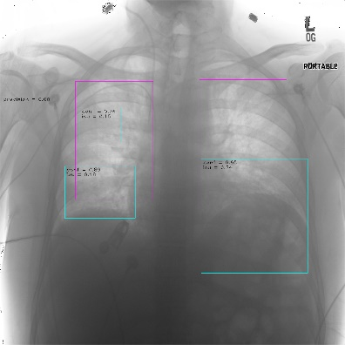
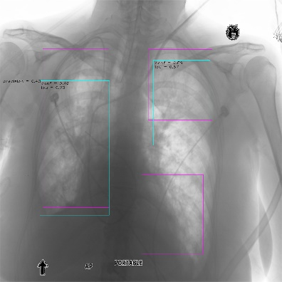
Prediction

Slide 29
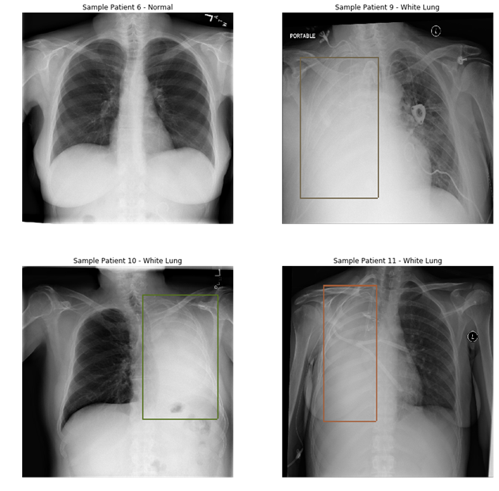
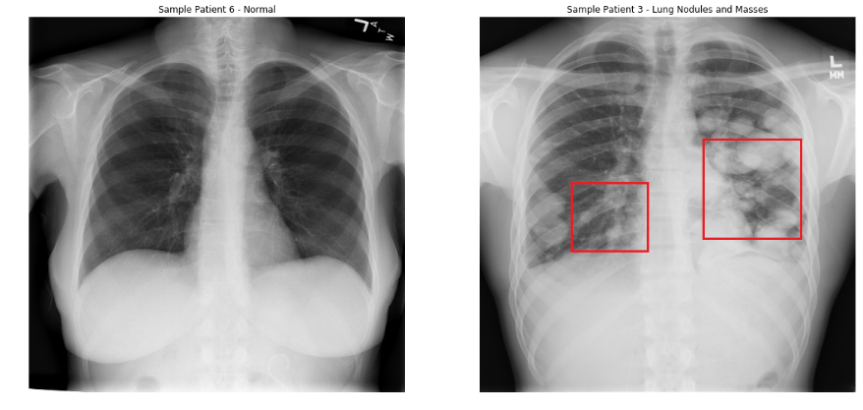
Disadvantages
White lung
Our model identifies other diseases that cause lung opacity as pneumonia.
Tumor in the lung

Slide 30
Advantages

Slide 31
05
More on COVID-19: The symptoms analysis

Slide 32
Description of the data set
Country: List of countries person visited.
Age: Classification of the age group for each person, based on WHO Age Group Standard.
Symptoms: According to WHO, 5 are major symptoms of COVID-19, Fever, Tiredness, Difficulty in breathing, Dry cough, and sore throat.
Experience any other symptoms: Pains, Nasal Congestion, Runny Nose, Diarrhea and Other.
Severity: The level of severity, Mild, Moderate, Severe
Contact: Has the person contacted some other COVID-19 Patient

Slide 33
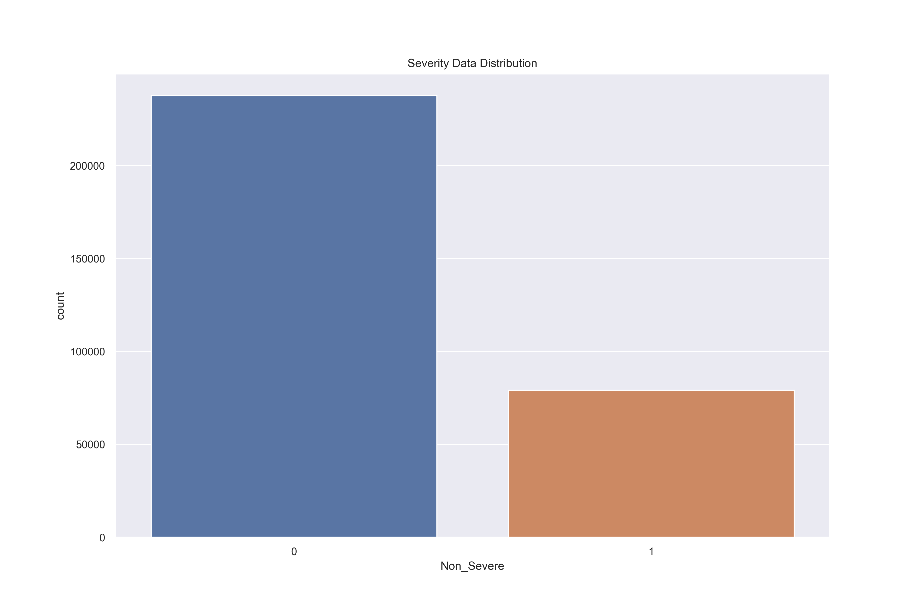
Visual analysis

Slide 34
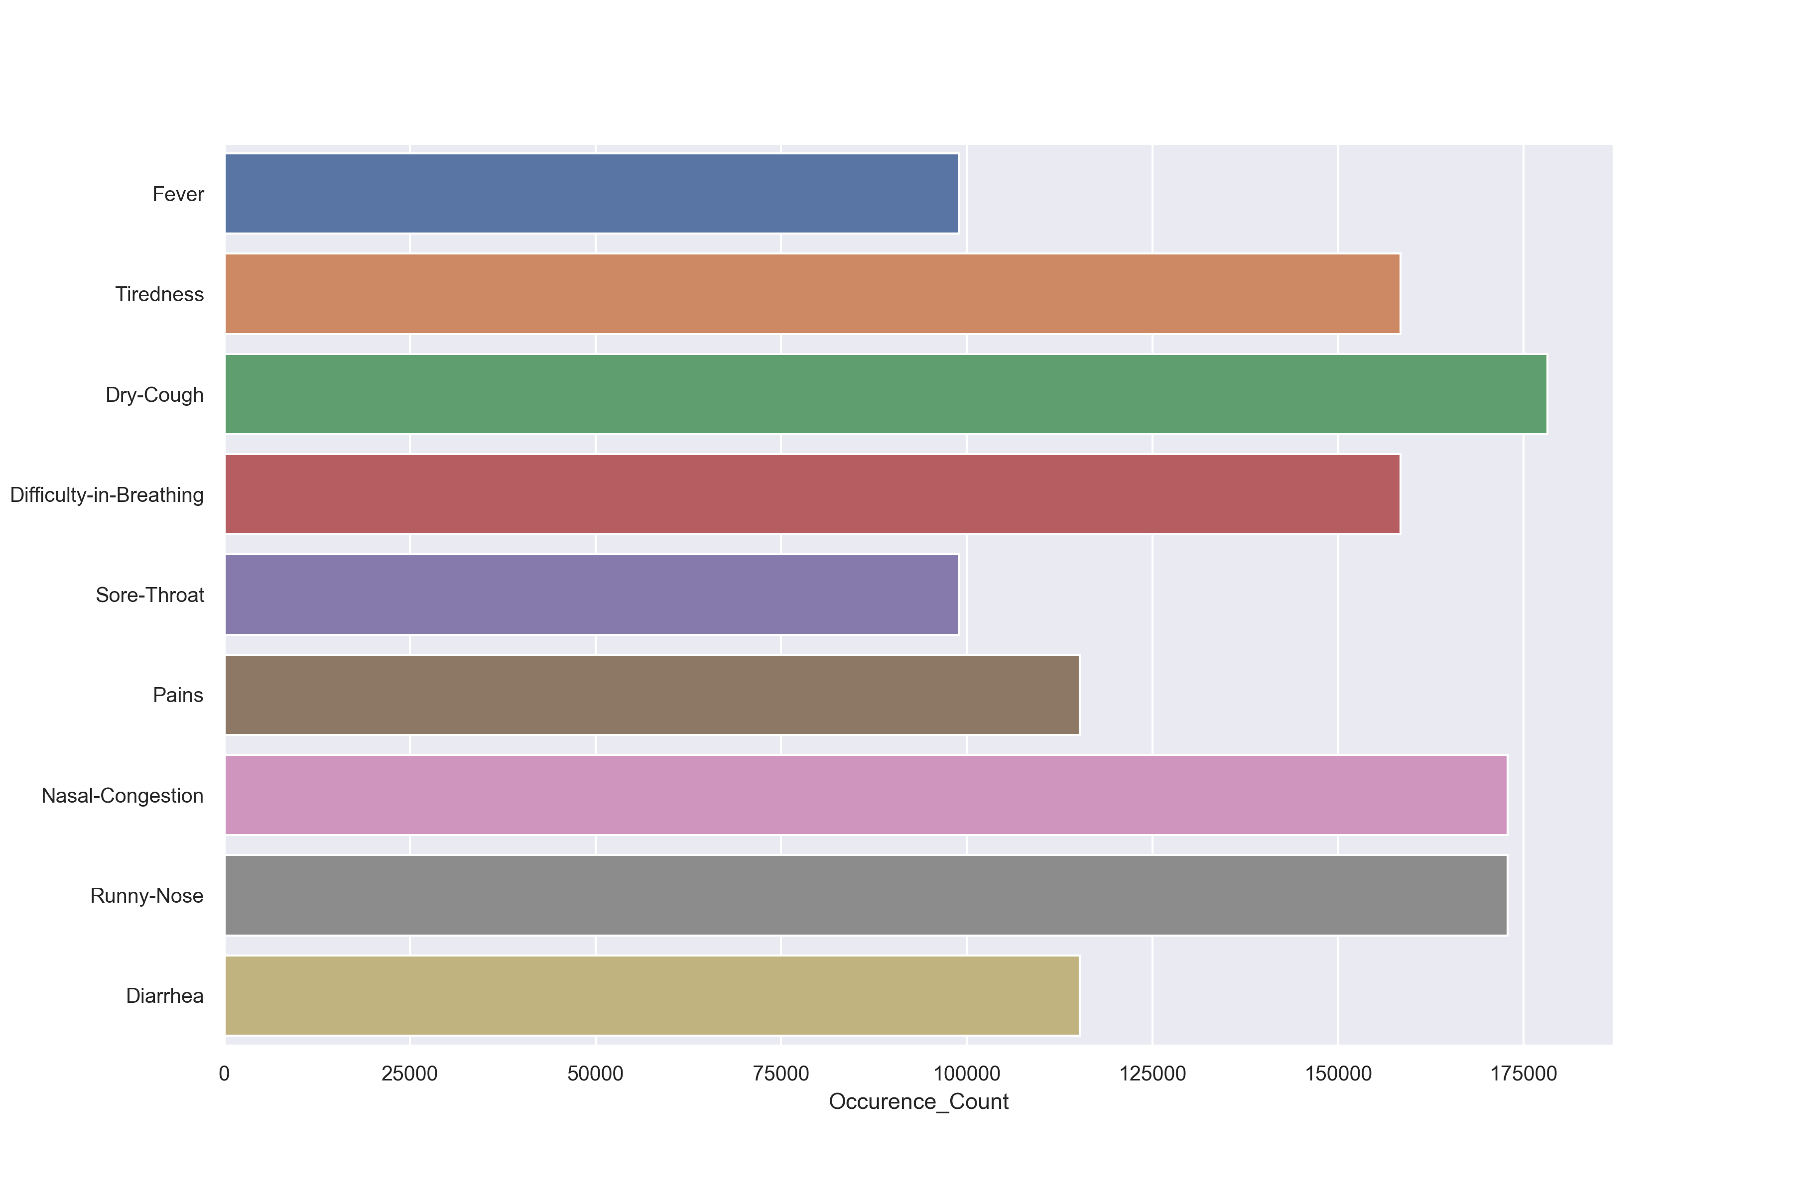
Visual analysis

Slide 35
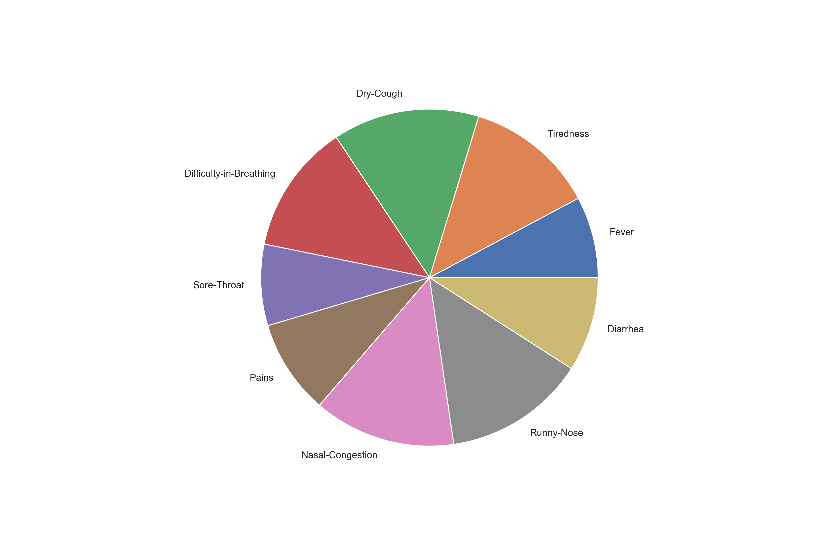
Visual analysis

Slide 36
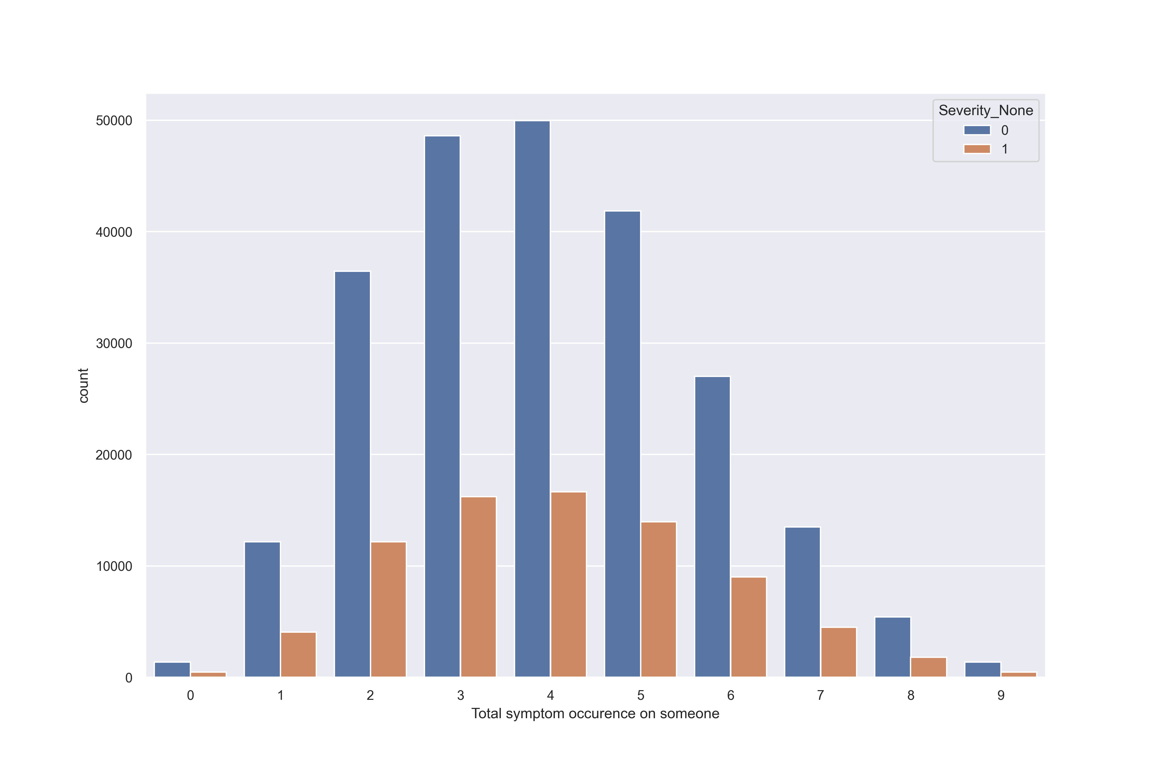
Visual analysis

Slide 37
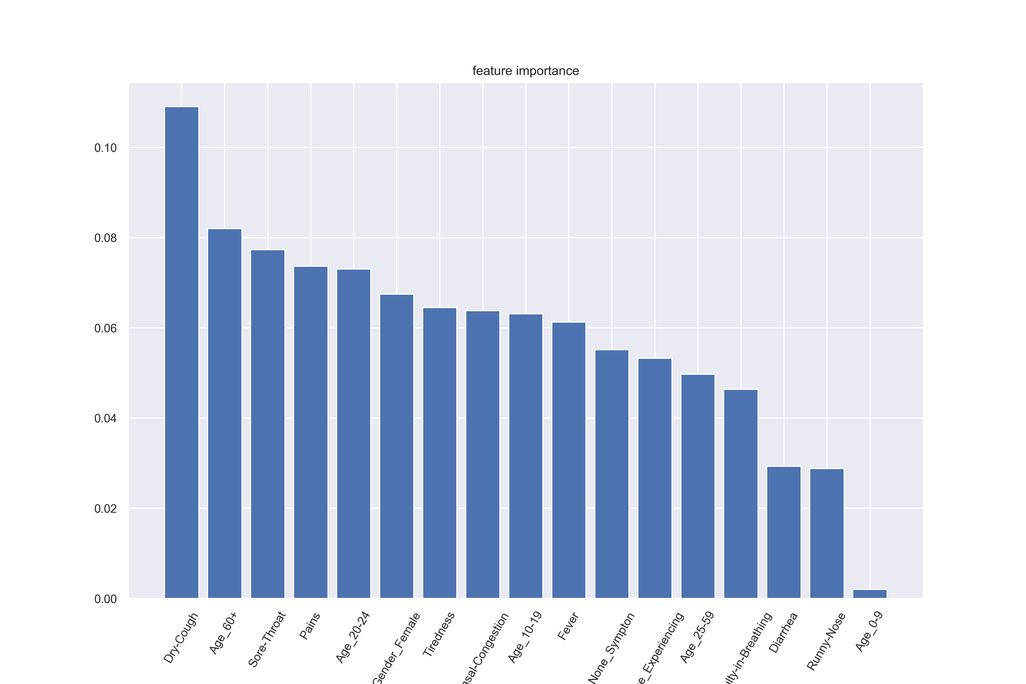
Random Forest Classifier

Slide 38
Thank you
Reporters: Jiawei Xiong, Yang Liu, Yicheng Wu, Cheng Zeng

